Slide 1
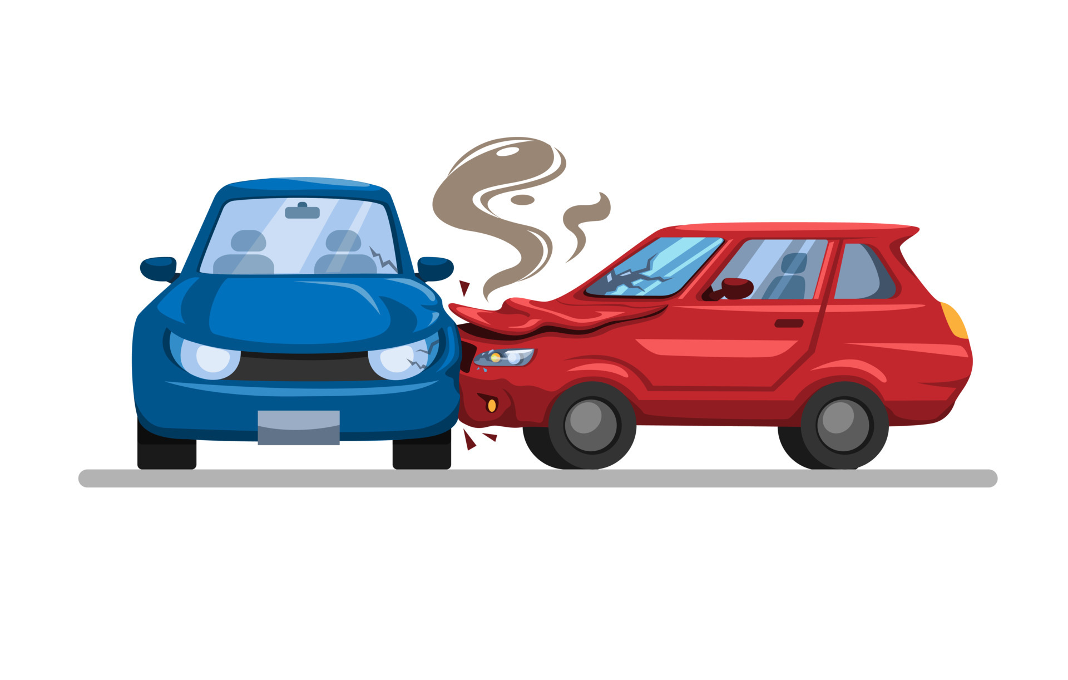
Accident detection using Tensor flow and cnn

Slide 2

AGENDA
INTRODUCTION
PROBLEM STATEMENT
PRIMARY GOALS
UNIQUENESS OF OUR SOLUTION
ARCHITECTURE
ALGORITHMS
SYSTEM REQUIREMENTS
DEVELOPING PROCESS
IMPLEMENTATION
PAHSE 1
PHASE 2
PHASE 3
FINAL OUTPUTS
FUTURE SCOPE
CONCLUSION

Slide 3
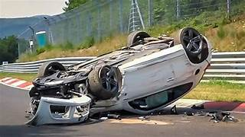
ABSTRACT
Accident Detection using Tensorflow and CNN is a project aimed at developing a system that leverages machine learning techniques to detect and classify accidents in real-time. The project focuses on utilizing Python and web technologies to create an efficient accident detection system.
Today road traffic accidents are a major reason for losing lives each day. The driver's mistake and late response time from the emergency services are the main cause of it. An effective road accident detection and information communication system is required in respecting of saving injured persons. A system being the sender of information messages to the required nearby emergency services about the location of the accident place for corrective response is needed. According to the research literature, several such systems are proposed that automatically detect accidents as by numerous researchers. These detection systems include smartphones, vehicular ad hoc networks, GSM and GPS technologies, and mobile applications.

Slide 4
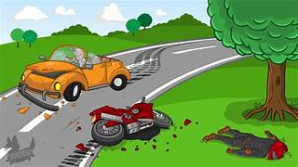
PROBLEM STATMENT
Accident detection systems need to be more efficient and accurate to ensure timely response and assistance in emergencies. Existing systems may not provide real-time detection or may have limited accuracy.
The motivation behind this project is to develop a reliable and efficient accident detection system that can help reduce response times, save lives, and minimize the impact of accidents on individuals and communities.
The statement emphasizes the shortcomings in current accident detection systems, including potential delays in recognizing accidents and limitations in accurately distinguishing between actual incidents and false alarms. Improving the efficiency and accuracy of these systems is essential to ensure that emergency services are promptly informed and can respond swiftly and appropriately to mitigate the impact of accidents

Slide 5
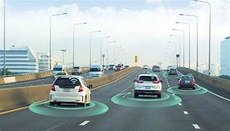
PRIMARY GOALS
The primary goals of the proposed accident detection system are to automate and enhance the accuracy of accident detection using machine learning algorithms. The system aims to classify various types of accidents, such as car collisions, falls, and emergencies, providing an understanding for tailored emergency responses. Through the integration of diverse sensors, including images and audio inputs, the system seeks to capture comprehensive data for real-time analysis. The overarching objective is to eliminate the limitations associated with manual reporting and costly sensor-based solutions, ensuring a swift and precise response to emergencies. Adaptability to different geographical areas and the ability to process multi-sensory data are key goals, contributing to the system's effectiveness in various environments. By achieving these goals, the proposed system aims to significantly improve the overall efficiency and responsiveness of accident detection, positively impacting public safety and emergency management.

Slide 6
UNIQUENESS OF OUR SOLUTION
Existing System:
Current accident detection systems often rely on manual reporting or sensor-based solutions,
which may not always be accurate or timely. Manual reporting can be delayed, while
sensor-based solutions may be costly and not always available in all areas.
Proposed System:
The proposed system utilizes Deep learning algorithms to automatically detect accidents happening and report to near by hospitals or emergency responders. The system sends the location of the area where the accident happened along with the data frame or picture of the accident scene.

Slide 7
ARCHITECTURE
The system architecture consists of:
● Data collection modules
● Preprocessing and feature extraction modules
● Machine learning model training and inference modules
● Real-time detection and alerting modules
● Web-based user interface for system monitoring and interaction

Slide 8
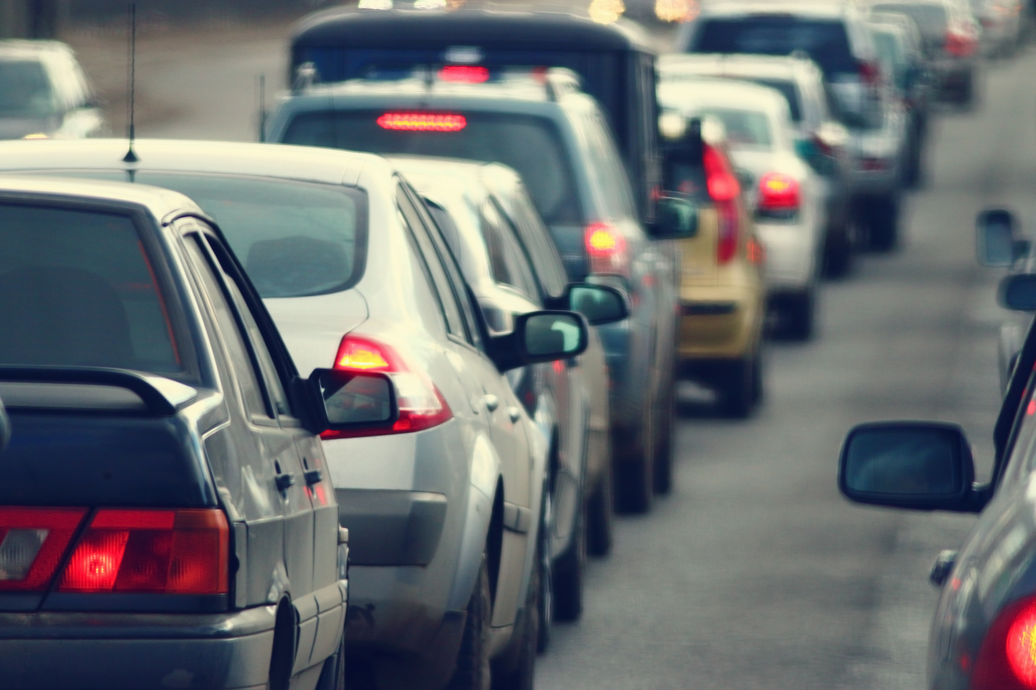
ALGORITHMS
● Convolutional Neural Networks (CNNs) for image classification.
Explanation: CNN is a deep learning algorithm commonly used for image classification and recognition tasks. It consists of multiple layers of convolutional and pooling operations followed by fully connected layers.
Application: In the accident detection system, CNN can be applied to analyze video feeds from traffic cameras and extract features such as vehicle positions, trajectories, and anomalies indicative of accidents.
Convolutional Neural Networks (CNNs) are commonly used in accident detection systems due to their ability to effectively process image data and extract relevant features for classification. Here's how CNNs can be used in accident detection

Slide 9


SYSTEM REQUIREMENTS
SYSTEM REQUIREMENTS
SOFTWARE
● Sufficient computational power for training and inference.
● Reliable internet connectivity for real-time detection and alerts.
Python programming language, libraries such as TensorFlow, Keras, and OpenCV for machine learning and computer vision tasks

Slide 10






DEVELOPING PROCESS
Data Collection
PREPROCESSING
Feature Extraction
Model Training
Real-Time Detection
ALERT
SYSTEM
Gathering data from various sources including images, audio, and sensor inputs.
Cleaning and preparing the data for input into machine learning algorithms.
Extracting relevant features from the data to train the machine learning models.
Training machine learning models to classify accidents based on input data.
Implementing algorithms for real-time accident detection using
trained models.
Notifying emergency services or relevant authorities upon detection of an
accident.

Slide 11
IMPLEMENTATION
To Develop a system for Accident detection using Tensorflow and CNN we divided the developing process into 3 phases
Phase 1-Data collection, Data preprocessing, Model Creation, Model Training ,Model Testing
Phase 2-Encapsulate the pre-trained model and predict the logic
Phase 3-Develop a webpage or accident detection system which uses a webcam feed in real-time to detect accidents and alert the emergency services

Slide 12
PHASE 1(MODEL CREATION AND TRAINING)
1. Data collection: collected data from Kaggle and images from Google. The dataset contains images of accidents and non-accidents split into train, test, and Val datasets
2. Import libraries: This step involves importing libraries and necessary modules for accessing functions, and classes to perform specific tasks
The libraries used in the implementation:
1)TensorFlow: For building and training neural networks.
2)Keras: High-level API for building and training deep learning models.
3)NumPy: For numerical computations.
4)pandas: For data manipulation and analysis.
5)Matplotlib: For data visualization.
.

Slide 13
PHASE 1 (CONT.)
3. Loading and pre-processing dataset: tf.keras.preprocessing.image_dataset_from_directory simplifies the process of loading image datasets, making it easier to work with image data in TensorFlow. The tf.keras.preprocessing.image_dataset_from_directory function in TensorFlow is a convenient utility for loading image datasets from a directory structure
4. Configuring Datasets for Evaluation:
Optimization: Cache datasets in memory for faster access.
Efficiency: Prefetch batches to overlap data preprocessing and model execution.
When dealing with large datasets for efficient processing we need to optimize data set performance by using caching and prefetching.
Caching involves storing dataset elements in memory or on disk after they are loaded for the first time. This allows subsequent iterations through the dataset to be faster since the data doesn't need to be reloaded from the original source. we use cache() to cache dataset in tensor flow

Slide 14
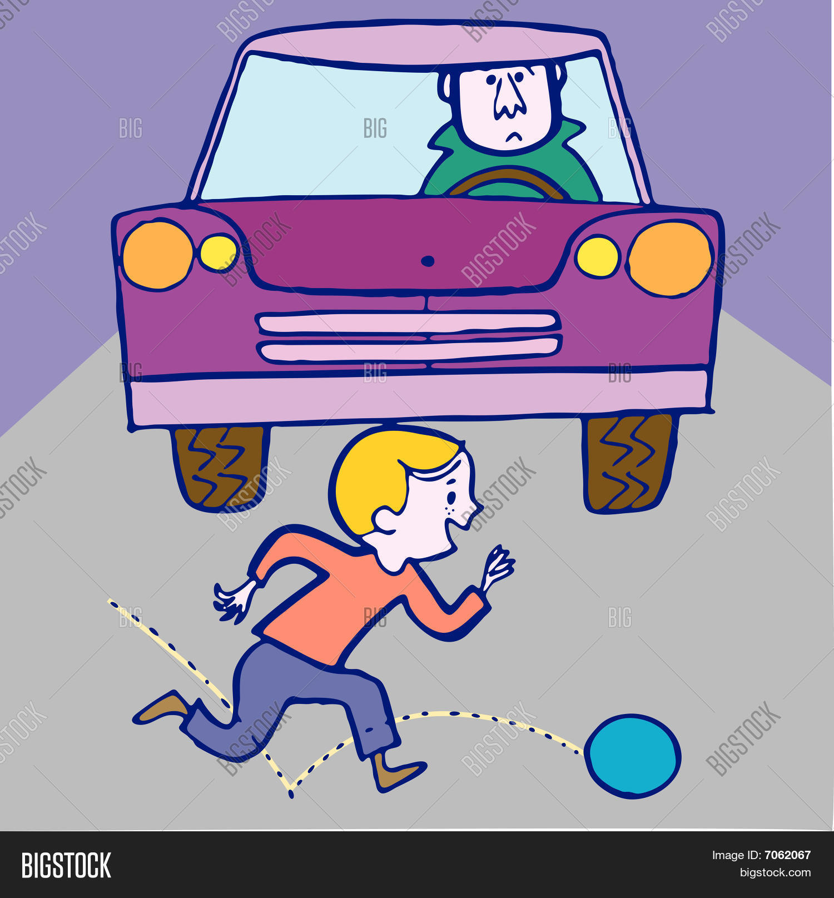
PHASE 1 (CONT.)
Prefetching overlaps the preprocessing and execution of training steps. While the model is executing training steps on a batch of data, the input pipeline is simultaneously preparing the next batch. This reduces the idle time of the model during training and improves overall efficiency. we use prefetch() function in tensor flow.
5. Model Architecture
Design: Sequential model using Keras.
Layers: Batch Normalization, Conv2D, MaxPooling2D, Flatten, Dense.
Activation: Specify activation functions for each layer (e.g., 'relu', 'softmax’).
In this step, we define the neural network, we defined a convolution neural network using TensorFlow Keras API

Slide 15
PHASE 1 (CONT.)
6. Model compilation:
1..Configuration: Use compile() method to set up a model for training.
2. Parameters: Specify optimizer ('adam'), loss function ('sparse_categorical_crossentropy’), and metrics ('accuracy’).
7. Model Training
Process: Train the model using fit() method on training dataset.
Validation: Validate model performance on the validation dataset.
Duration: Train for a specific number of epochs (e.g., 10).
8. Visualization of Training Results
Plotting: Use Matplotlib to visualize training loss and accuracy over epochs.
Evaluation: Monitor validation loss and accuracy during training.
9. Visualization of Testing Results
Testing: Generate predictions on the testing dataset.
Display: Plot a subset of testing images with predicted and actual labels.

Slide 16
PHASE 1 (CONT.)
10. Saving the Trained Model
Preservation: Save the trained model to a file using save() method (e.g., 'Model.h5’).
11. Model Visualization Representation:
Use plot_model from Keras to visualize model architecture.
Output: Save the model plot to a file (e.g., 'model_plot.png').

Slide 17
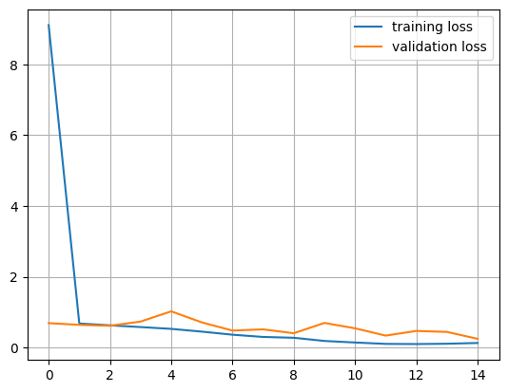
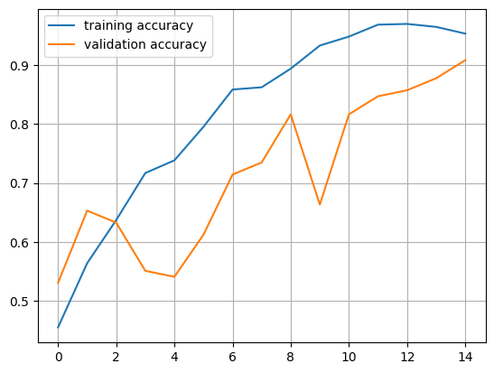
OUTPUT PLOTS
TRAINING LOSS VS VALIDATION LOSS
TRAINING ACCURACY VS VALIDATION ACCURACY

Slide 18
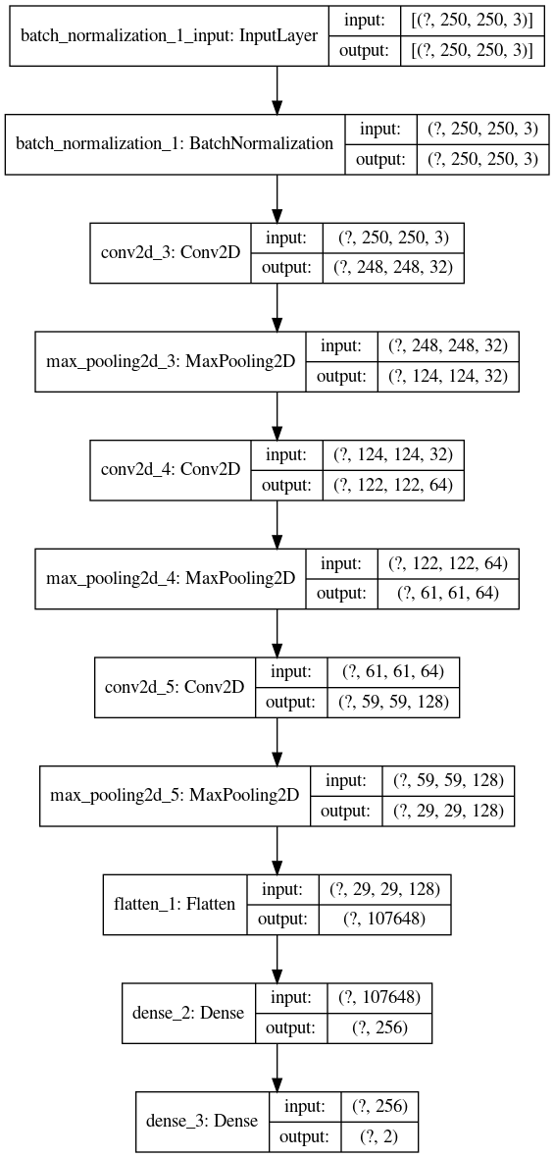
FINAL MODEL

Slide 19
PHASE-2
This code defines a class `AccidentDetectionModel` that wraps a Keras model for detecting accidents in images. Here's a breakdown of its components:
1. import statements: This imports necessary modules from Keras and NumPy.
2. AccidentDetectionModel Class:
a.class_nums: A class variable containing the labels for the two classes: 'Accident' and 'No Accident'.
b. __init__(): The constructor method which takes two arguments: `model_json_file` (path to the JSON file containing the model architecture) and `model_weights_file` (path to the file containing the model's weights). It loads the model architecture from the JSON file and then loads the weights into the model.

Slide 20
PHASE 2 CONT.
c.predict_accident(): This method takes an image (`img`) as input and returns a prediction for whether the image contains an accident or not. It uses the loaded model to make predictions on the input image.
3. predict_accident() method:
a. It uses the `predict()` method of the loaded model to get the predictions for the input image.
b. It then selects the class label with the highest probability from the predictions using `np.argmax(self.preds)`.
c. Finally, it returns the predicted class label and the raw prediction probabilities.
Overall, this class provides a convenient interface for loading a pre-trained Keras model for accident detection and making predictions on new images.

Slide 21
PHASE 3
In this phase we developed an accident detection system using a webcam feed in real-time. This module utilizes OpenCV for video capture, and it uses a pre-trained accident detection model to classify whether there is an accident in the frame.
Brief Overview process in this phase:
1. Imports necessary libraries.
2. Defines functions for getting the current location and sending an email with an attachment.
3. Initializes the accident detection model.
4. Starts capturing video from the webcam.
.

Slide 22
PHASE 3 (CONT.)
5. In a loop:
- Reads each frame from the video.
- Converts the frame to grayscale.
- Resizes the frame to the required size for model input.
- Uses the accident detection model to predict whether there is an accident.
- If an accident is detected with high probability:
- Plays a beep sound.
- Captures the frame and saves it as an image.
- Sends an email notification with the captured frame attached.
- Draws bounding boxes and labels on the frame based on the prediction.
- Displays the frame with annotations.
- Terminates the loop if the 'q' key is pressed.

Slide 23
FINAL OUTPUTS
Fig: Home Page
Fig: Manually upload videos

Slide 24
FINAL OUTPUTS
Fig: Upload image manually
Fig: Upload live video

Slide 25
FINAL OUTPUTS
Fig: Accident Not Detected
Fig: Accident Detected

Slide 26
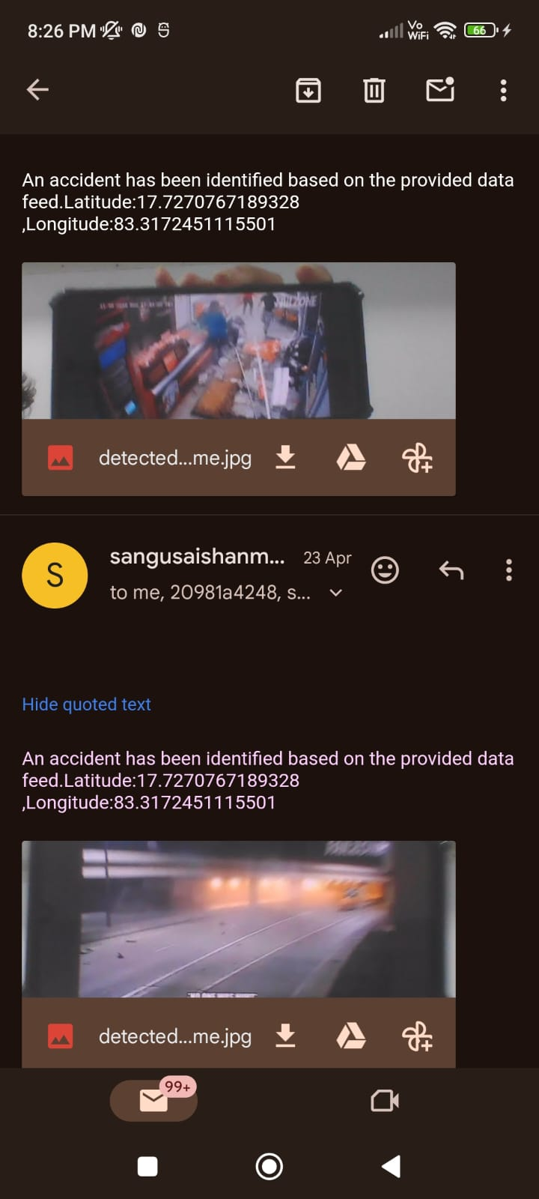
FINAL OUTPUTS
Fig: Accident Detected
Fig: Email alert system

Slide 27
FUTURE SCOPE
Improved Accuracy: By leveraging Deep learning models trained on labeled datasets, the system can accurately identify accidents with high precision, minimizing false positives and false negatives.
Real-Time Response: The system's ability to process real-time data streams enables prompt detection of accidents, triggering automatic alerts and facilitating coordinated response efforts by emergency services and traffic operators.
Enhanced Traffic Management: Integration with traffic management infrastructure allows for dynamic adjustments to traffic flow, route diversions, and emergency service dispatches, optimizing road network efficiency and reducing congestion.
User-Friendly Interface: The user interface provides stakeholders with intuitive tools for visualizing realtime traffic data, accessing historical accident records, and managing system configurations, enhancing usability and facilitating informed decision-making.

Slide 28
FUTURE SCOPE
Looking ahead, future iterations of the project could explore additional functionalities, such as predictive analytics, multimodal data fusion, and integration with emerging technologies like edge computing and IoT.
Furthermore, ongoing evaluation, refinement, and collaboration with stakeholders will be essential to ensure the continued success and relevance of the accident detection system in addressing evolving challenges in transportation safety and urban mobility.
In summary, the "Accident Detection Using Deep learning" project holds great promise for improving road

Slide 29
conclusion
In conclusion, the Accident Detection using Tensorflow and CNN project aims to address the shortcomings of existing accident detection systems by leveraging machine learning techniques to provide accurate and timely detection of accidents, ultimately contributing to improved emergency response and safety measures.

Slide 30
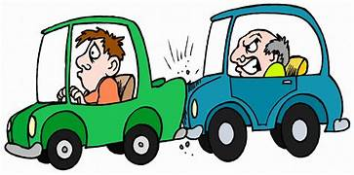
THANK YOU!

